Slide 1

BIG DATA ANALYTICS UNIT:2 HADOOP
Compiled By:- SRIKANTH DASARI
MALLAREDDY University

Slide 2
Contents
2
Data format, analyzing data with Hadoop, scaling out,
Hadoop streaming, Hadoop pipes,
design of Hadoop distributed file system (HDFS), HDFS concepts,
Java interface, data flow, Hadoop I/O, data integrity, compression, serialization,
Avro, file-based data structures, MapReduce workflows, unit tests
with MRUnit, test data and local tests,
anatomy of MapReduce job run, classic Map-reduce,
YARN, failures in classic Map-reduce and YARN, job scheduling,
shuffle andsort, task execution,
MapReduce types, input formats, output formats

Slide 3
Apache Hadoop
3
Hadoop is an open-source software framework for storing and
processing large datasets ranging in size from gigabytes to petabytes.
Hadoop was developed at the Apache Software Foundation in 2005.
It is written in Java.
The traditional approach like RDBMS is not sufficient due to the heterogeneity of the data.

Slide 4
Apache Hadoop
4
So Hadoop comes as the solution to the problem of big data i.e. storing and processing the big data with some extra capabilities.
Its co-founder Doug Cutting named it on his son’s toy elephant.
There are mainly two components of Hadoop which are :
🞑 Hadoop Distributed File System (HDFS)
🞑 Yet Another Resource Negotiator(YARN).

Slide 5

Why Hadoop?
5
Hadoop is designed to scale up from a single server to thousands of machines, each offering local computation and storage.
Applications built using HADOOP are run on large data sets distributed across clusters of commodity computers.
Commodity computers are cheap and widely available, these are useful for achieving greater computational power at a low cost.
In Hadoop data resides in a distributed file system which is called a Hadoop Distributed

Slide 6
HDFS
6
In Hadoop data resides in a distributed file system which is called a Hadoop Distributed File system.
HDFS splits files into blocks and sends them across various nodes in form of large clusters.
The Hadoop Distributed File System (HDFS) is based on the Google File System (GFS) and provides a distributed file system that is designed to run on commodity hardware.
Commodity hardware is cheap and widely available, these are useful for achieving greater computational power at a low cost.

Slide 7
HDFS
7
It is highly fault-tolerant and is designed to be deployed on low-cost hardware.
It provides high throughput access to application data and is suitable for applications having large datasets.
Hadoop framework includes the following two modules :
🞑 Hadoop Common: These are Java libraries and utilities required by other Hadoop modules.
🞑 Hadoop YARN: This is a framework for job scheduling and cluster resource management

Slide 8
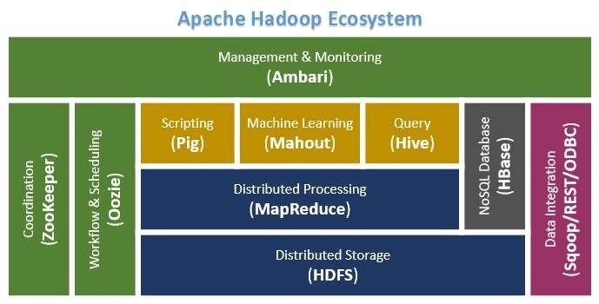
Hadoop Ecosystem/
Architecture
8

Slide 9
Hadoop Core Components
9
Hadoop Distributed File System (HDFS):
🞑 Data can be distributed over a cluster of computers
Yet Another Resource Negotiator (YARN):
🞑 This is a framework for job scheduling and cluster resource management.
Hadoop MapReduce:
🞑 This is YARN-based system for parallel processing of large data sets.

Slide 10
Other Ecosystem Components/Projects
10
Ambari™: A web-based tool for provisioning, managing, and monitoring Apache Hadoop clusters which includes support for Hadoop HDFS, Hadoop MapReduce, Hive, HCatalog, HBase, ZooKeeper, Oozie, Pig and Sqoop.
Avro™: A data serialization system.
Cassandra™: A scalable multi-master database with no single points of failure.
Chukwa™: A data collection system for managing large distributed systems.
Flume™: A tool used to collect, aggregate and move huge amounts of streaming data into HDFS.

Slide 11
Other Ecosystem Components/Projects
11
HBase™: A scalable, distributed database that supports structured data storage for large tables.
Hive™: A data warehouse infrastructure that provides data summarization and ad hoc querying.
Mahout™: A Scalable machine learning and data mining
library.
Oozie™: A server-based workflow scheduling system to manage Hadoop jobs;
Pig™: A high-level data-flow language and execution
framework for parallel computation.

Slide 12
Other Ecosystem Components/Projects
12
Spark™: A fast and general compute engine for Hadoop
data. Spark programming applications.
provides a simple model that supports a
and expressive wide range of
Scoop™: A connectivity tool for moving data between relational databases and data warehouses and Hadoop.
Tez™: A generalized data-flow programming framework, built on Hadoop YARN, which provides a powerful and flexible engine.
ZooKeeper™: A high-performance coordination service for distributed applications. it is a highly available service used for the management of Hadoop operations, and many components of Hadoop depend on it.

Slide 13
DATA FORMAT
13
A data/file format defines how information is stored in HDFS.
Hadoop does not have a default file format and the choice of a format depends on its use.
The big problem in the performance of applications that use HDFS is the information search time and the writing time.
Managing the processing and storage of large volumes of information is very complex that’s why a certain data format is required.

Slide 14
DATA FORMAT
14
The choice of an appropriate file format can produce the following benefits:
🞑 Optimum writing time
🞑 Optimum reading time
🞑 File divisibility
🞑 Adaptive scheme and compression support

Slide 15
DATA FORMAT
15
Some of the most commonly used formats of the Hadoop ecosystem are :
Text/CSV: A plain text file or CSV is the most common format both outside and within the Hadoop ecosystem.
SequenceFile: The SequenceFile format stores the data in binary format, this format accepts compression but does not store metadata.

Slide 16
DATA FORMAT
16
Avro: Avro is a row-based storage format. This format includes the definition of the scheme of your data in JSON format. Avro allows block compression along with its divisibility, making it a good choice for most cases when using Hadoop.
Parquet: Parquet is a column-based binary storage format that can store nested data structures. This format is very efficient in terms of disk input/output operations when the necessary columns to be used are specified.

Slide 17
DATA FORMAT
17
RCFile (Record Columnar File): RCFile is a columnar format that divides data into groups of rows, and inside it, data is stored in columns.
ORC (Optimized Row Columnar): ORC is considered an evolution of the RCFile format and has all its benefits alongside some improvements such as better compression, allowing faster queries.

Slide 18
Analysing Data with Hadoop :
18
While the MapReduce programming model is at the heart of Hadoop, it is low-level and as such becomes an unproductive way for developers to write complex analysis jobs.
To increase developer productivity, several higher-level languages and APIs have been created that abstract away the low-level details of the MapReduce programming model.
There are several choices available for writing data analysis jobs.
.

Slide 19
Analysing Data with Hadoop :
19
The Hive and Pig projects are popular choices that provide SQL-like and procedural data flow- like languages, respectively.
HBase is also a popular way to store and analyze data in HDFS. It is a column-oriented database, and unlike MapReduce, provides random read and write access to data with low latency.
MapReduce jobs can read and write data in HBase’s table format, but data processing is often done via HBase’s own client API.

Slide 20
Hadoop Streaming :
22
It is a feature that comes with a Hadoop distribution that allows developers or programmers to write the Map- Reduce program using different programming languages like Ruby, Perl, Python, C++, etc.
We can use any language that can read from the standard input(STDIN) like keyboard input and all and write using standard output(STDOUT).
Although Hadoop Framework is completely written in java programs for Hadoop do not necessarily need to code in Java programming language.
.

Slide 21
Hadoop Streaming :
23
The main advantage of the Hadoop streaming utility is that it allows Java as well as non-Java programmed MapReduce jobs to be executed over Hadoop clusters.
The Hadoop streaming supports the Perl, Python, PHP, R, and C++ Translate the application logic into the Mapper and Reducer sections with the key and value output elements.
Three main components: Mapper, Reducer, and Driver.

Slide 22
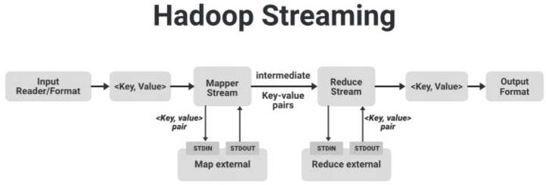
Hadoop Streaming :
24

Slide 23
Hadoop Streaming :
25
We have an Input Reader which is responsible for reading the input
data and produces the list of key-value pairs.
We can read data in .csv format, in delimiter format, from a database table, image data(.jpg, .png), audio data etc.
This list of key-value pairs is fed to the Map phase and Mapper will work on each of these key-value pair of each pixel and generate some intermediate key-value pairs.
After shuffling and sorting, the intermediate key-value pairs are fed to the Reducer:
then the final output produced by the reducer will be written to the
HDFS. These are how a simple Map-Reduce job works.

Slide 24
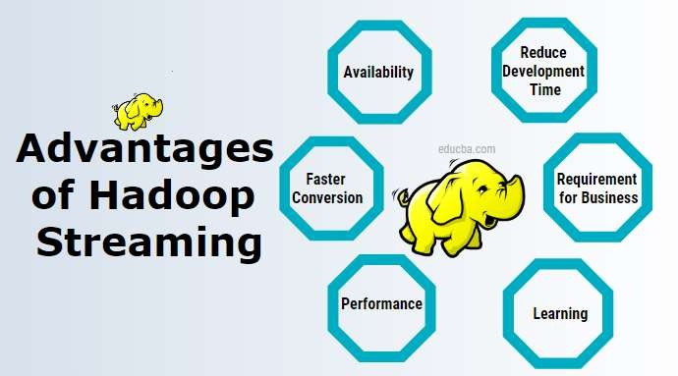
Hadoop Streaming :
26

Slide 25
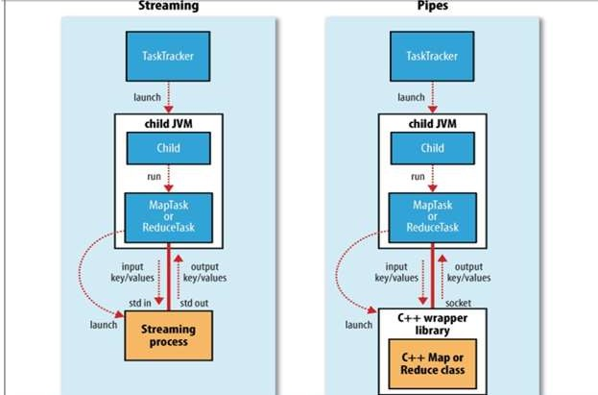
Hadoop Pipes :
27
Hadoop Pipes is the name of the C++ interface to Hadoop MapReduce.
Unlike Streaming, this uses standard input and output to communicate with the map and reduce code.
Pipes uses sockets as the channel over which the task tracker communicates with the process running the C++ map or reduce function.

Slide 26
Design of HDFS :
28
HDFS is a filesystem designed for storing very large files with streaming data access patterns, running on clusters of commodity hardware.
Very large files:
“Very large” in this context means files that are hundreds of megabytes, gigabytes, or terabytes in size. There are Hadoop clusters running today that store petabytes of data.
Streaming data access :
HDFS is built around the idea that the most efficient data processing pattern is a write-once, read-many-times pattern. A dataset is typically generated or copied from source, then various analyses are performed on that dataset over time.

Slide 27
Design of HDFS :
29
Commodity hardware :
Hadoop doesn’t require expensive, highly reliable hardware to run on. It’s designed to run on clusters of commodity hardware (commonly available hardware available from multiple vendors3) for whichthe chance of node failure across the cluster is high, at least for large clusters.
HDFS is designed to carry on working without a noticeable interruption to the user in the face of such failure.

Slide 28
Design of HDFS :
30
Features of HDFS :
It is suitable for the distributed storage and processing.
Hadoop provides a command interface to interact with HDFS.
The built-in servers of namenode and datanode help users to easily check the status of cluster.
Streaming access to file system data.
HDFS provides file permissions and authentication.

Slide 29
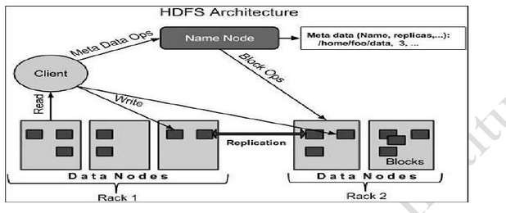
Architecture of HDFS :
31

Slide 30
32
Namenode
The namenode is the commodity hardware that contains the GNU/Linux operating system and the namenode software. It is a software that can be run on commodity hardware.
The system having the namenode acts as the master server
and it does the following tasks −
Manages the file system namespace.
Regulates client’s access to files.
It also executes file system operations such as renaming, closing, and opening files and directories.

Slide 31
33
Datanode
The datanode is a commodity
hardware having the
GNU/Linux operating system and datanode software. For every node (Commodity hardware/System) in a cluster, there will be a datanode.
These nodes manage the data storage of their system.
Datanodes perform read-write operations on the file systems, as per client request.
They also perform operations such as block creation, deletion, and replication according to the instructions of the namenode.

Slide 32
34
Block
Generally the user data is stored in the files of HDFS. The file in a file system will be divided into one or more segments and/or stored in individual data nodes.
These file segments are called as blocks. In other words, the minimum amount of data that HDFS can read or write is called a Block.
The default block size is 64MB, but it can be increased
as per the need to change in HDFS configuration.

Slide 33
35
Goals of HDFS
Fault detection and recovery − Since HDFS includes a large number of commodity hardware, failure of components is frequent. Therefore HDFS should have mechanisms for quick and automatic fault detection and recovery.
Huge datasets − HDFS should have hundreds of nodes per
cluster to manage the applications having huge datasets.
Hardware at data − A requested task can be done efficiently, when the computation takes place near the data. Especially where huge datasets are involved, it reduces the network traffic and increases the throughput.

Slide 34
36
Advantages of HDFS:
It is inexpensive, immutable in nature, stores data reliably,
ability process more.
to tolerate
a large amount
faults, scalable,
block structured, can
and many
of data simultaneously
Disadvantages of HDFS:
It’s the biggest disadvantage
is that it is not fit for small has issues related to potential
quantities of data. Also, it
stability, restrictive and rough in nature. Hadoop also supports a wide range of software packages such as Apache Flumes, Apache Oozie, Apache HBase, Apache Sqoop, Apache Spark, Apache Storm, Apache Pig, Apache Hive, Apache Phoenix, Cloudera Impala.

Slide 35
What precautions HDFS is taking to recover file system in
case of namenode failure:
37
The first way is to back up the files that make up the persistent state of the filesystem metadata. Hadoop can be configured so that the namenode writes its persistent state to multiple filesystems. These writes are synchronous and atomic. The usual configuration choice is to write to local disk as well as a remote NFS mount.
Second Way:It is also possible to run a secondary namenode, which despite its name does not act as a namenode. Its main role is to periodically merge the namespace image with the edit log to prevent the edit log from becoming too large. But this can shaped to act as primary namenode

Slide 36
Hadoop I/O
38
Hadoop comes with a set of primitives for data I/O.
Some of Hadoop, deserve datasets.
these are techniques that are more general than such as data integrity and compression, but special consideration when dealing with multiterabyte
Others are Hadoop tools or APIs that form the building blocks for developing distributed systems, such as serialization frameworks and on-disk data structures

Slide 37
Data Integrity
39
Users of Hadoop rightly expect that no data will be lost or
corrupted during storage or processing.
However, since every I/O operation on the disk or network carries with it a small chance of introducing errors into the data that it is reading or writing, when the volumes of data flowing through the system are as large as the ones Hadoop is capable of handling, the chance of data corruption occurring is high.
The usual way of detecting corrupted data is by computing a checksum for the data when it first enters the system, and again whenever it is transmitted across a channel that is unreliable and hence capable of corrupting the data. The data is deemed to be corrupt if the newly generated checksum doesn’t exactly match the original.

Slide 38
Data Integrity in HDFS
40
This technique doesn’t offer any way to fix the data—merely error detection. (And this is a reason for not using low-end hardware; in particular, be sure to use ECC memory.)
Note that it is possible that it’s the checksum that is corrupt, not the data, but this is very unlikely, since the checksum is much smaller than the data.
HDFS transparently checksums all data written to it and by default verifies checksums when reading data. A separate checksum is created for every io.bytes.per.checksum bytes of data.
The default is 512 bytes, and since a CRC-32 checksum is 4
bytes long, the storage overhead is less than 1%.

Slide 39

Data Integrity in HDFS
41
Datanodes are responsible for verifying the data they receive
before storing the data and its checksum. This applies to data that
they receive from clients replication. If it detects
and from other datanodes during an error, the client receives a
ChecksumException, a subclass of IOException.
When clients read data from datanodes, they verify checksums as well, comparing them with the ones stored at the datanode. When a client successfully verifies a block, it tells the datanode, which updates its log. Keeping statistics such as these is valuable in detecting bad disks.
Aside from block verification on client reads, each datanode runs a DataBlockScanner in a background thread that periodically verifies all the blocks stored on the datanode. This is to guard against corruption due to “bit rot” intoe physical storage media.

Slide 40
Developing A Map-Reduce Application :
Writing a program in MapReduce follows a certain pattern.
You start by writing your map and reduce functions, ideally with unit tests to make sure they do what you expect.
Then you write a driver program to run a job, which can run from your IDE using a small subset of the data to check that it is working.
If it fails, you can use your IDE’s debugger to find the source of the
problem.
When the program runs as expected against the small dataset, you are ready to unleash it on a cluster.
Running against the full dataset is likely to expose some more issues, which you can fix by expanding your tests and altering your mapper or reducer to handle the new cases.

Slide 41
Developing A Map-Reduce Application :
After the program is working, you may wish to do some tuning :
🞑 First by running through some standard checks for making MapReduce
programs faster
🞑 Second by doing task profiling.
Profiling distributed programs are not easy, but Hadoop has hooks
to aid in the process.
Before we start writing a MapReduce program, we need to set up and configure the development environment.
Components in Hadoop are configured using Hadoop’s own configuration API.

Slide 42
Developing A Map-Reduce Application :
An instance of the Configuration class represents a collection of
configuration properties and their values.
Each property is named by a String, and the type of a value may be one of several, including Java primitives such as boolean, int, long, and float and other useful types such as String, Class, and java.io.File; and collections of Strings.

Slide 43
THANK YOU.

